Slide 1
Introduction (Unit1)
Part3

Slide 2

Emerging Concept of Marketing
Emerging concept in marketing" refers to new ideas, trends, strategies, or approaches that are gaining traction and shaping the future of marketing practices. These concepts often arise in response to changes in consumer behavior, advancements in technology, shifts in market dynamics, or evolving societal values and expectations. They are characterized by their innovative nature and potential to disrupt traditional marketing practices. They may introduce novel ways of engaging with customers, delivering value, and achieving business objectives.

Slide 3
Relationship Marketing
In a competitive market, it is not enough to build relationship only with customer, it is equally important to establish relationship with the vendors, intermediaries and other influence group as well as the stakeholders.
Relationship marketing is a strategy that focuses on building long-term relationships with customers rather than solely emphasizing one-time transactions. It centers on fostering loyalty, trust, and satisfaction among customers by delivering personalized experiences and maintaining ongoing communication and engagement. The goal of relationship marketing is to create strong connections with customers, leading to repeat business, positive word-of-mouth referrals, and increased customer lifetime value.

Slide 4
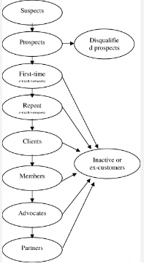
Customer Development Process
Customer development is a framework businesses use for deciding whether a product can fulfill the specific needs of the target customers. It is a component of the lean startup concept that comprises business model design, agile engineering, and customer development. Customer development is used to understand the problem and determine whether or not a solution would fulfill customers’ needs. It can also be understood as a process of defining your target customer and validating your solution hypotheses within it. It helps in checking the feasibility of a minimum viable product.

Slide 5
Prospects – strongly interested in the offerings and can pay for it.
First-time customers – convert to Repeat customers, may continue to buy from competitors.
Repeat customers – convert to Clients, may continue to buy from competitors.
Clients – convert to Advocates, only buy from the company in relevant categories.
Advocates – convert to Partners, praise the company and encourage others to buy from it.
Partners – the customer actively works with the company to get customers or improve the business or opportunities.
The goal of all this is to develop more loyal customers and increase sales revenue. However, the company must spend more to build greater customer loyalty. The correct levels investment in customer-relationship building with the Customer Development Process will yield more profitability for the companies.

Slide 6
Contribution of Relationship Marketing
It helps building harmonious relationship not only with customer but also with the distributers, stakeholders and other segment of the society.
Encourages understanding the complaints and dissatisfaction of the customer and makes salesperson accountable to satisfy them.
Help understanding the actual need and desire of the customer.
Help developing committed customer for the marketer.
Overall, relationship marketing contributes to the overall success and profitability of businesses by prioritizing customer relationships, fostering loyalty and satisfaction, and creating value for both customers and the business.

Slide 7
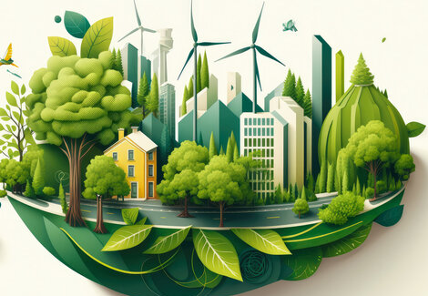
Green Marketing
As the name indicates, green marketing is a strategy deployed for promoting products and services on their real and perceived sustainability. In some cases, the product itself is tailored to be environmentally friendly. In others, the process of developing the goods and services incorporates an eco-friendly approach.
Green marketing, also known as sustainable marketing or environmental marketing, refers to the practice of promoting products, services, and brands that are environmentally friendly or have a positive impact on the planet. It involves incorporating ecological considerations into various aspects of the marketing mix, including product design, packaging, distribution, advertising, and promotion.

Slide 8
Why should one consider it?
Join the movement in making the earth a better, more livable place.
It’s a powerful component of your corporate social responsibility.
It puts your business in the spotlight, especially in a highly competitive setting.
Pursue business innovations that manage your carbon footprint and help increase your profit at the same time.
Leverage it to break into new customer segments.
Forge lasting customer trust when you resonate with your audience’s values and advocacy.

Slide 9
Phases of Green Marketing
Ecological Marketing: Ecological marketing, also known as eco-marketing or eco-friendly marketing focuses on promoting products and services that minimize environmental impact and promote sustainability. It involves integrating ecological considerations into various aspects of marketing strategy, including product design, packaging, distribution, promotion, and pricing. The goal is to meet the needs of consumers while also preserving and protecting the environment.
Environmental Marketing: It refers to the promotion of products and services that are environmentally friendly or have a reduced impact on the environment and should balance customer need. It involves incorporating environmental considerations into various aspects of marketing strategy, including product design, packaging, distribution, promotion, and pricing. It focus shifted on clean technology that involve designing of innovative new product that take care of pollution and waste issue.

Slide 10
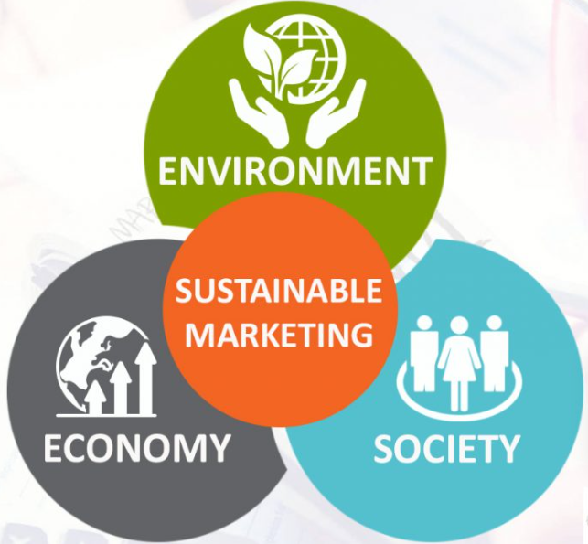
Sustainable Marketing:
Sustainable consumption is what consumers want today, especially the conscious millennial. Sustainable marketing is a holistic approach with the aim of satisfying the wants and needs of the customers while putting equal emphasis on environmental and social issues, thus generating profit in a responsible way. The framework for sustainable marketing consists of the three pillars of sustainability: environment, society, and economy. Sustainable marketing is in the middle of this intersection. A sustainable brand is one that has successfully integrated environmental, economic and social issues into its business operations.

Slide 11
Component of Green marketing
Green marketing incorporates various components to promote environmentally friendly products and practices. These components are integrated into the overall marketing strategy to communicate the environmental benefits of products and services to consumers. Here are some key components of green marketing:
Product Design and Development: Green marketing begins with the design and development of products that have minimal environmental impact. This includes using sustainable materials, reducing energy and water consumption during manufacturing, and ensuring products are recyclable or biodegradable.
Packaging: Packaging plays a significant role in green marketing. Companies strive to use eco-friendly packaging materials, minimize packaging waste, and design packaging that is easily recyclable or compostable. Green marketing messages may also be included on packaging to communicate a product's environmental attributes.

Slide 12
Price and Value Proposition: Green marketing communicates the value proposition of environmentally friendly products to consumers. While green products may sometimes have a higher price point due to the use of sustainable materials or production methods, companies emphasize the long-term benefits, such as energy savings or durability, to justify the price.
Promotion and Advertising: Green marketing campaigns promote environmentally friendly products and practices through various channels, including traditional advertising, digital marketing, social media, and public relations. These campaigns highlight the environmental benefits of products and emphasize the company's commitment to sustainability.
Consumer Education and Engagement: Green marketing involves educating consumers about the environmental benefits of products and encouraging sustainable behavior. This may include providing information about recycling, energy conservation tips, and the importance of choosing environmentally friendly products.

Slide 13
Corporate Social Responsibility (CSR): Green marketing is closely tied to corporate social responsibility initiatives. Companies demonstrate their commitment to sustainability through CSR activities such as community involvement, environmental stewardship programs, and transparency in reporting environmental performance.
Certifications and Labels: Green marketing often utilizes certifications and eco-labels to verify the environmental credentials of products. Certifications such as Energy Star, USDA Organic, or Fair Trade provide reassurance to consumers that products meet certain environmental standards and criteria.

Slide 14
Problems of Green Marketing
While green marketing holds the promise of promoting sustainability and environmentally friendly products, it also faces several challenges and potential pitfalls. Here are some problems commonly encountered in green marketing:
Greenwashing: Perhaps the most significant issue in green marketing is greenwashing, where companies make false or exaggerated claims about the environmental benefits of their products or practices. This can mislead consumers and undermine trust in green marketing efforts. Greenwashing may involve highlighting minor eco-friendly features while ignoring larger environmental impacts or using vague or misleading language in marketing messages.
Cost and Perceived Value: Green products often come with a higher price tag due to the use of sustainable materials or production methods. Consumers may be unwilling to pay a premium for green products, especially if they perceive the environmental benefits as negligible or if they prioritize cost over sustainability. Companies must effectively communicate the value proposition of green products to justify the higher price and encourage adoption.

Slide 15
Lack of Standards and Certifications: The absence of clear standards and certifications for green products and practices can make it challenging for consumers to distinguish genuine environmentally friendly products from those that are merely greenwashed. While certifications like Energy Star or USDA Organic exist, they may not cover all aspects of sustainability, leading to confusion and skepticism among consumers.
Limited Market Demand: Despite growing interest in sustainability, there may still be limited demand for green products, particularly in certain market segments. Consumers may prioritize factors such as price, convenience, or product performance over environmental considerations when making purchasing decisions. Companies must carefully assess market demand and consumer preferences to determine the viability of green marketing strategies
Complexity and Confusion: Green marketing messages can be complex and difficult for consumers to understand. Terms like "sustainable," "eco-friendly," or "natural" lack standardized definitions and can be interpreted differently by different people. This ambiguity can lead to confusion and skepticism among consumers, making it challenging for companies to effectively communicate the environmental benefits of their products.

Slide 16

Thank you

